Slide 1
Web Architecture

Slide 2
Contents
Internet
WWW
Web Server
HTTP protocol

Slide 3
Internet
The internet is a massive network of networks, a networking infrastructure.
It connects millions of computers together globally, forming a network in which any computer can communicate with any other computer as long as they are both connected to the internet.
Information that travels over the internet does so via a variety of languages known as protocols.

Slide 4
Protocols
An agreed-upon format for transmitting data between two devices. The protocol determines the following:
the type of error checking to be used
data compression method, if any
how the sending device will indicate that it has finished sending a message
how the receiving device will indicate that it has received a message
There are a variety of standard protocols from which programmers can choose. Each has particular advantages and disadvantages; for example, some are simpler than others, some are more reliable, and some are faster.
From a user's point of view, the only interesting aspect about protocols is that your computer or device must support the right ones if you want to communicate with other computers. The protocol can be implemented either in hardware or in software.

Slide 5
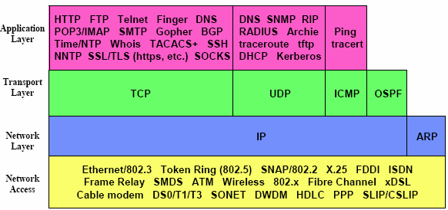

Slide 6
Common Examples
HTTP - Hypertext Transfer Protocol is used to send and receive webpages and files on the internet.
FTP - The File Transfer Program is a standard network protocol used for the transfer of computer files between a client and server on a computer network.
DNS - Domain Name System is a system used to convert a computer's host name into an IP address on the Internet.
DSL - Digital subscriber line ( originally digital subscriber loop) is a family of technologies that are used to transmit digital data over telephone lines.
TCP/IP – consist of:
Transmission Control Protocol (TCP), which uses a set of rules to exchange messages with other Internet points at the information packet level.
Internet Protocol (IP), which uses a set of rules to send and receive messages at the Internet address level.

Slide 7
Evolution of the Internet
The Internet originated as ARPANET in September 1969 and had two main goals:
Allow scientists at different physical locations to share information and work together
Function even if part of the network were disabled or destroyed by a disaster

Slide 8
World Wide Web
The World Wide Web, or simply web, is a way of accessing information over the medium of the internet. It is an information-sharing model that is built on top of the internet.
The web uses the HTTP protocol, only one of the languages spoken over the internet, to transmit data.
Web services, which use HTTP to allow applications to communicate in order to exchange business logic, use the web to share information.
The web also utilizes browsers, such as Internet Explorer or Firefox, to access Web documents called webpages that are linked to each other via hyperlinks. Web documents also contain graphics, sounds, text and video.

Slide 9
Web Server
Web server job is to:
host web content (static / dynamic)
Support technologies for efficient creation, deployment and distribution of content
Support multiple concurrent user requests
Support secure communication
Support multiple websites / applications simultaneously
Modern Web servers
Apache
IIS

Slide 10
Summary of WWW Architecture
WWW is a collection of resources in a web server
Each resource is identified by one or more URIs which are unique to the resource
Each resource can have multiple representations e.g. HTML, XHTML, XML, image, etc
Users use a web agent (e.g. browser, download manager, etc) to access a resource, which is a 3-step process:
Identification
Interaction
Interpretation

Slide 11
Identification
Purpose is to locate resources
Managed through URIs
URI is a general syntax to represent a URL or URN
Interaction
Purpose is to retrieve resource representations
Managed through HTTP Protocol
Other protocols such as HTTPS, SOAP, etc. may also be used
Interpretation
Purpose is to understand resource representation and present respective information to user
Managed through HTML, CSS, Javascript, etc.

Slide 12
HTTP Protocol (Message Based)
Message is either
Request: from client to server
Response: from server to client
Each Message comprises of
Start Line: defines the message type and other identifying information
Message Header: contains meta data
Message Body: contains the actual body of message – generally the entity associated with the message. It may or may not be empty depending upon the Message Type

Slide 13
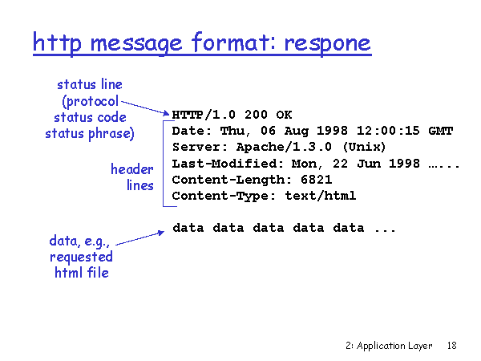
Entity
An entity is the content that is intended to be transferred between the client and the server
Entity may be further divided into:
Header: That contains meta-information about the body that helps in proper interpretation of body
Body: The actual content to be delivered
Examples of Entity:
HTML Document
XML Document, etc

Slide 14
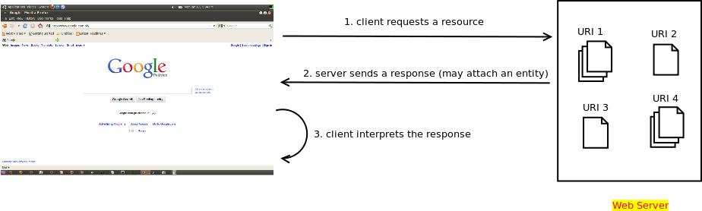
Server-side technologies:
Servlets/JSP/PHP/ASP.NET etc.
May be used to generate
response dynamically
Client side technologies used
to interpret the response
Html: basic language
CSS: styling and layout
Javascript: DOM manipulation

